Slide 1
Joins

Slide 2
Join in SQL
SQL Join is used to fetch data from two or more tables, which is joined to appear as single set of data.
SQL Join is used for combining column from two or more tables by using values common to both tables.
Join Keyword is used in SQL queries for joining two or more tables.
Minimum required condition for joining table, is
(n-1) where n, is number of tables.
A table can also join to itself known as, Self Join.

Slide 3
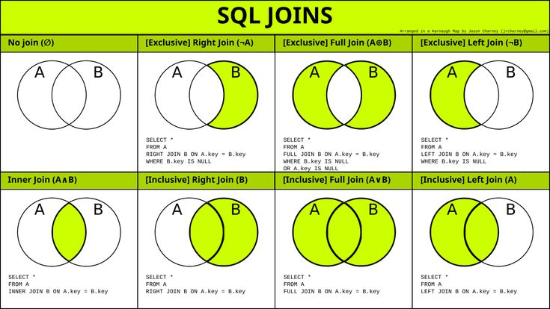
Types of Join

Slide 4
INNER Join or EQUI Join
•
This is a simple JOIN in which the result is based on matched data as per the equality condition specified in the query.
Syntax
SELECT column-name-list from table-name1
INNER JOIN
table-name2
WHERE table-name1.column-name = table- name2.column-name;

Slide 5
SELECT * from class, classinfo where class.id = classinfo.id;
 | ID | NAME
1 |  | ABHI
2 |  | ADAM
3 |  | ALEX
4 |  | ANU
 | ID | Address
1 | DELHI
2 | MUMBAI
3 | CHENNAI
 | ID | NAME |  | ID | Address
1 |  | ABHI | 1 |  | DELHI
2 |  | ADAM | 2 |  | MUMBAI
3 |  | ALEX | 3 |  | CHENNAI

Slide 6
Cross JOIN or Cartesian Product
•
This type of JOIN returns the Cartesian product of rows of from the tables in Join. It will return a table which consists of records which combines each row from the first table with each row of the second table.
Cross JOIN Syntax is, SELECT column-name-list from table-name1 CROSS JOIN
table-name2;

Slide 7
SELECT * from class, cross JOIN classinfo; class classinfo
ID NAME
1 ABHI
2 ADAM
4 ALEX
 | ID | Address
1 | DELHI
2 | MUMBAI
3 | CHENNAI
 | ID | NAME |  | ID | Address
1 |  | ABHI | 1 |  | DELHI
2 |  | ADAM | 1 |  | DELHI
4 |  | ALEX | 1 |  | DELHI
1 |  | ABHI | 2 |  | MUMBAI
2 |  | ADAM | 2 |  | MUMBAI
4 |  | ALEX | 2 |  | MUMBAI
1 |  | ABHI | 3 |  | CHENNAI
2 |  | ADAM | 3 |  | CHENNAI
4 |  | ALEX | 3 |  | CHENNAI

Slide 8
Natural JOIN
Natural Join is a type of Inner join which is based on column having same name and same data type present in both the tables to be joined.
Syntax
SELECT *
from table-name1
NATURAL JOIN
table-name2;

Slide 9
SELECT * from class NATURAL JOIN classinfo;
class classinfo
 | ID | NAME
1 |  | ABHI
2 |  | ADAM
3 |  | ALEX
4 |  | ANU
 | ID | Address
1 | DELHI
2 | MUMBAI
3 | CHENNAI
 | ID | NAME | Address
1 |  | ABHI | DELHI
2 |  | ADAM | MUMBAI
3 |  | ALEX | CHENNAI

Slide 10
Outer JOIN
Outer Join is based on both matched and unmatched data.
Left Outer Join Right Outer Join Full Outer Join

Slide 11
Left Outer Join
The left outer join returns a result table with the matched data of two tables then remaining rows of the left table and null for the right table's column.
Syntax
SELECT column-name-list from table-name1
LEFT OUTER JOIN
table-name2
on table-name1.column-name = table-name2.column-name;

Slide 12
SELECT * FROM class LEFT OUTER JOIN classinfo ON (class.id=classinfo.id);
 | ID |  | NAME
1 |  | ABHI
2 |  | ADAM
3 |  | ALEX
4 |  | ANU
5 |  | ASHISH
 | ID | Address
1 | DELHI
2 | MUMBAI
3 | CHENNAI
7 | NOIDA
8 | PANIPAT
 | ID | NAME | ID | ADDRESS
1 |  | ABHI | 1 | DELHI
2 |  | ADAM | 2 | MUMBAI
3 |  | ALEX | 3 | CHENNAI
4 |  | ANU | NULL | NULL
5 |  | ASHISH | NULL | NULL

Slide 13
Right Outer Join
The right outer join returns a result table with the matched data of two tables then remaining rows of the right table and null for the left table's columns.
Syntax
select column-name-list from table-name1 RIGHT OUTER JOIN
table-name2
on table-name1.column-name = table-name2.column-name;

Slide 14
select * from class right outer join classinfo on (class.id=classinfo.id);
ID NAME
1 | ABHI
2 | ADAM
3 | ALEX
4 | ANU
5 | ASHISH
ID ADDRESS
1 | DELHI
2 | MUMBAI
3 | CHENNAI
7 | NOIDA
8 | PANIPAT
ID | NAME |  | ID | ADDRESS
1 | ABHI | 1 |  | DELHI
2 | ADAM | 2 |  | MUMBAI
3 | ALEX | 3 |  | CHENNAI
NULL | NULL | 7 |  | NOIDA
NULL | NULL | 8 |  | PANIPAT

Slide 15
Full Outer Join
The full outer join returns a result table with the matched data of two table then remaining rows of both left table and then the right table.
Syntax
select column-name-list from table-name1
FULL OUTER JOIN
table-name2
on table-name1.column-name = table-name2.column-name;

Slide 16
SELECT * FROM class FULL OUTER JOIN classinfo on (class.id=classinfo.id);
 | ID | NAME
1 |  | ABHI
2 |  | ADAM
3 |  | ALEX
4 |  | ANU
5 |  | ASHISH
ID ADDRESS
1 | DELHI
2 | MUMBAI
3 | CHENNAI
7 | NOIDA
8 | PANIPAT
 | ID | NAME | ID | ADDRESS
1 |  | ABHI | 1 | DELHI
2 |  | ADAM | 2 | MUMBAI
3 |  | ALEX | 3 | CHENNAI
4 |  | ANU | NULL | NULL
5 |  | ASHISH | NULL | NULL

